Slide 1
Phishing Awareness Training Protecting Yourself from Online Scams and Cyber Threats
Prepared by: ADEPU SNEHA Internship: CodeAlpha Cyber Security Internship

Slide 2
Introduction
In today's digital world, cyber criminals use various techniques to steal personal information, passwords, and financial data. One of the most common cyberattacks is phishing. Phishing attacks trick users into revealing sensitive information through fake emails, messages, or websites.
This training aims to help users recognize phishing attempts and stay safe online.

Slide 3
What is Phishing?
Phishing is a cybercrime where attackers pretend to be trusted organizations or individuals to steal sensitive information.
Common Targets:
Login credentials
Banking information
Credit card details
Personal information
Company data
Common Methods:
Emails
SMS (Smishing)
Phone calls (Vishing)
Fake websites
Social media messages

Slide 4
How Phishing Works?
Step 1:
Attacker creates a fake email or website.
Step 2:
Victim receives a message appearing to come from a trusted source.
Step 3:
Victim clicks the malicious link.
Step 4:
Victim enters personal information.
Step 5:
Attacker steals the data and misuses it.

Slide 5
How to Recognize Phishing Emails:
1. Unknown sender
2. Spelling and grammar mistakes
3. Urgent or threatening language
4. Suspicious links
5. Requests for passwords or personal information
6. Unexpected attachments
Example:
"Your account will be suspended in 24 hours! Click here immediately."
Legitimate companies rarely ask for sensitive information through email.

Slide 6
Identifying Fake Websites
Check for:
1.HTTPS and security lock symbol
2.Correct domain name
3.Poor design and spelling mistakes
4.Unusual pop-ups
5.Requests for sensitive information
Example:
Real Website: www.amazon.com
Fake Website: www.amaz0n-security.com
Notice the difference in the spelling.

Slide 7
Social Engineering Tactics:
Social engineering is the psychological manipulation of people into revealing confidential information.
Common Tactics:
1. Urgency
"Act now or your account will be locked."
2. Fear
"Your bank account has been compromised."
3. Curiosity
"See who viewed your profile."
4. Trust
Pretending to be a bank, government agency, or company representative.
5. Reward
"You won a free smartphone!"

Slide 8
Real-World Example:
Example Scenario:
A user receives an email claiming to be from a bank:
"Dear Customer,
We detected suspicious activity on your account. Please verify your account immediately by clicking the link below."
The link leads to a fake banking website.
The user enters login credentials.
The attacker gains access to the user's bank account.
Lesson:
Always verify emails and visit websites directly instead of clicking links.

Slide 9
Best Practices to Avoid Phishing
Do:
Verify sender information
Check URLs carefully
Use strong passwords
Enable Multi-Factor Authentication (MFA)
Keep software updated
Report suspicious emails
Use antivirus software
Don't:
Click suspicious links
Open unknown attachments
Share passwords via email
Trust unsolicited messages

Slide 10
What To Do If You Become a Victim:
Immediate Actions:
1. Change passwords immediately.
2. Enable MFA.
3. Contact your bank if financial information was exposed.
4. Scan your device for malware.
5. Report the incident to your organization or IT team.
6. Monitor accounts for suspicious activity.

Slide 11
Interactive Quiz
Question 1
You receive an email asking you to verify your password immediately.
A) Click the link and verify
B) Ignore warning signs
C) Verify through the official website
Answer: C
Question 2
Which is a common sign of phishing?
A) Correct domain name
B) Urgent requests for personal information
C) Secure HTTPS connection
Answer: B

Slide 12
Question 3
What should you do before clicking a link?
A) Click immediately
B) Check the URL carefully
C) Share it with friends
Answer: B
Question 4
What is social engineering?
A) Software update
B) Network configuration
C) Manipulating people to reveal information
Answer: C

Slide 13
Key Takeaways:
Think before you click:
*Verify emails and websites
*Never share passwords
*Use MFA whenever possible
*Stay alert to social engineering tactics
*Report suspicious activity immediately
Cybersecurity starts with awareness and caution.

Slide 14
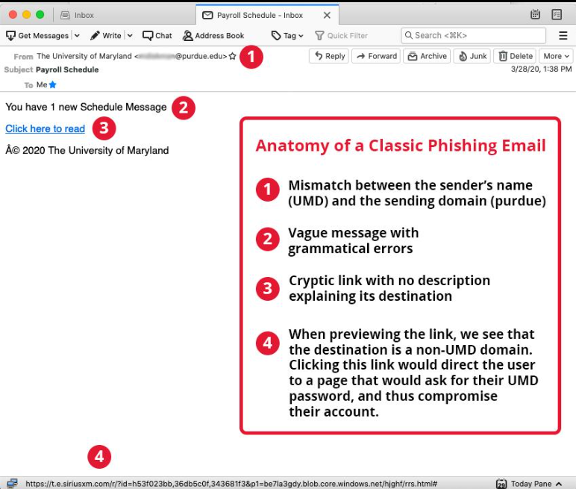
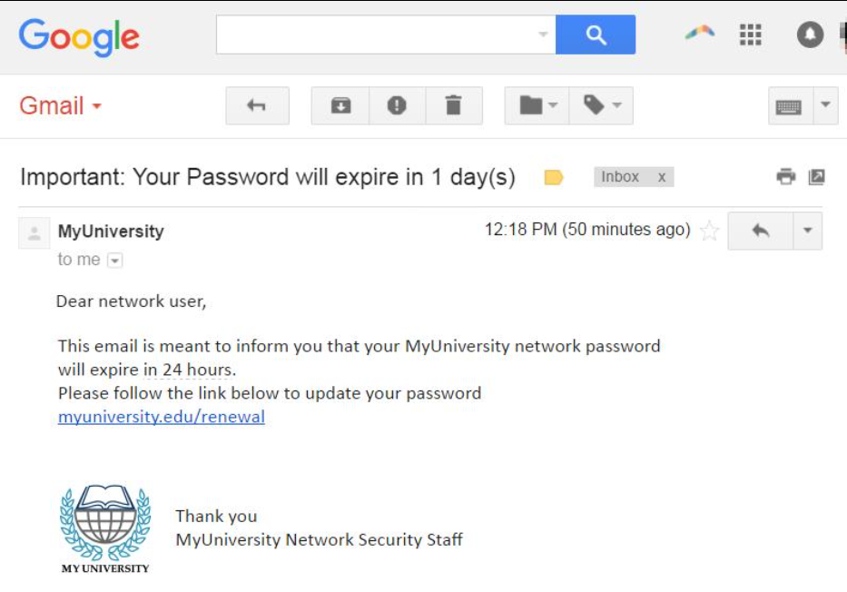
Screenshots of phishing emails:

Slide 15
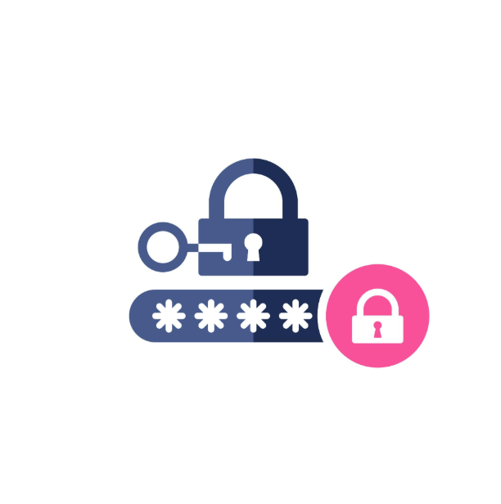
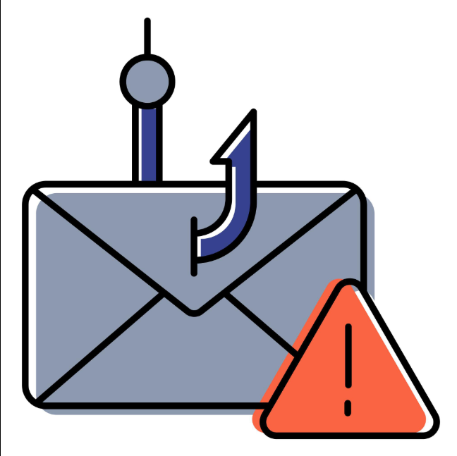
Cybersecurity Icons:

Slide 16
CONCLUSION
Cybersecurity Starts With You
Every click matters.
Every password matters.
Every decision matters.
By staying alert and following cybersecurity best practices, we can protect ourselves, our organizations, and our digital future from phishing attacks.
Stay Aware • Stay Secure • Stay Protected

